Slide 1

SoC-Now
Mini SoC Generator by MERL-UIT

Slide 2
Team Introduction
Shahzaib Kashif (shazaib@students.uit.edu)
Talha Ahmed (tahmed@students.uit.edu)
Muhammad Shahzaib (mshahzaib@students.uit.edu)

Slide 3
Agenda
Demonstration of SoC-Now
Overview of SoC-Now Pillars
Carvan
Jigsaw
Cachefy
NucleusRV

Slide 4
Pillars
SoC-Now consists of the following four pillars
Caravan: API for connecting Bus Interconnects by use of generic interfaces
Jigsaw: API for connecting Devices by use of generic interfaces.
Cachefy: API for connecting Cache Memories.
NucleusRV: RISC-V based Core.

Slide 5
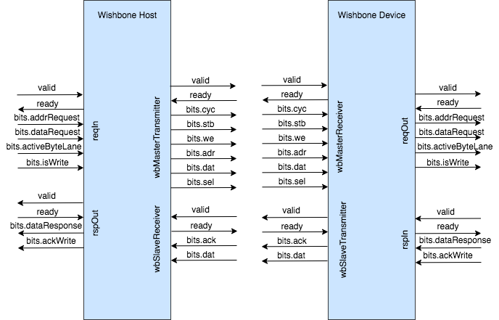
Caravan
Caravan provides generic Request and Response Interfaces to connect Buses

Slide 6
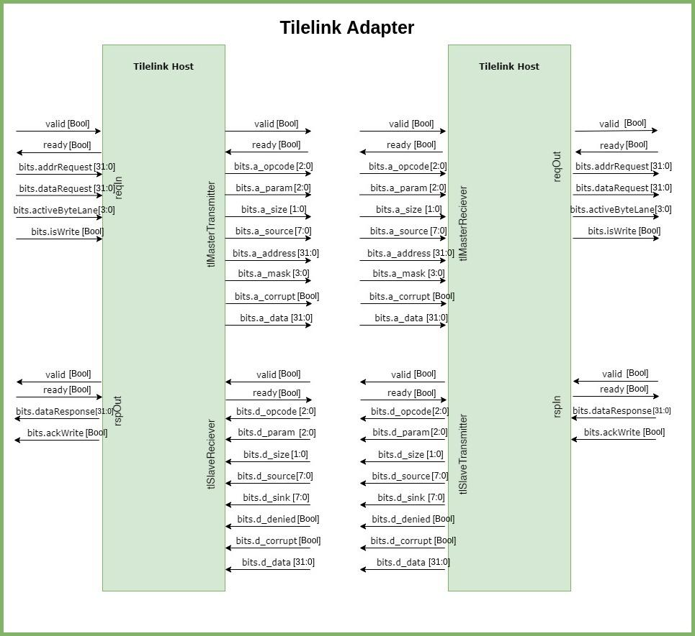
Caravan
Tilelink Host
Tilelink Device
Caravan provides generic Request and Response Interfaces to connect Buses

Slide 7
Jigsaw
Tilelink Host
Tilelink Device
UART
Jigsaw connects devices with Caravan’s generic interfaces
reqIn
rspOut

Slide 8
NucleusRV
Tilelink Host
Tilelink Device
Core
UART
RISC-V based 32 bit core having I, M, F (partial) and C (partial) extensions
reqIn
reqOut
rspOut
rspIn

Slide 9
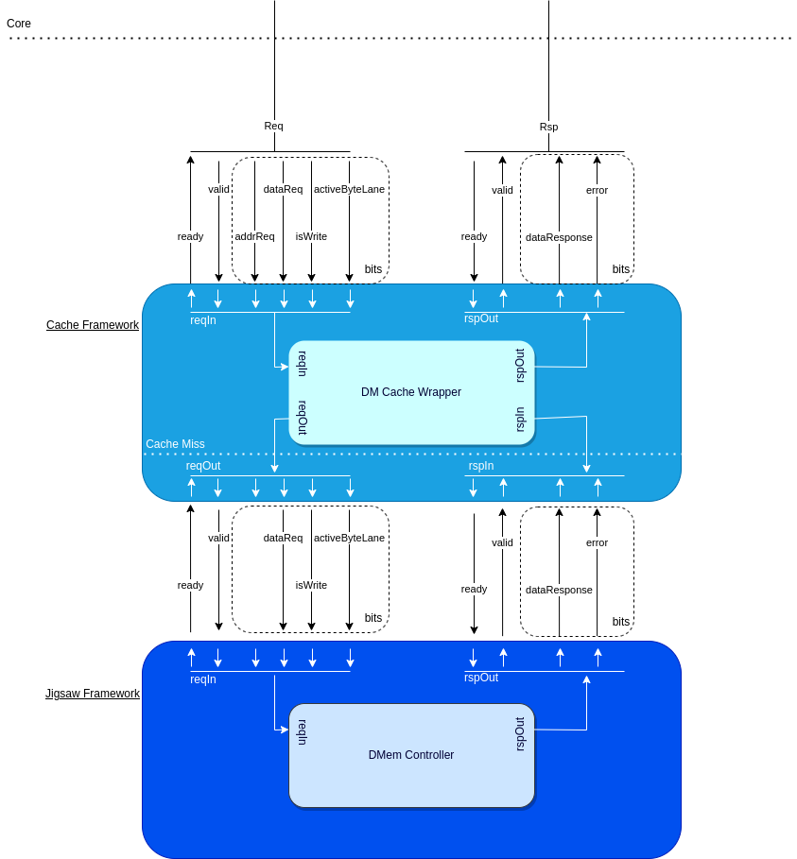
Cachefy
Cachefy connects cache memories with Caravan’s generic interfaces

Slide 10
Thank You
www.merledupk.org

